Slide 1

Business Analytics Capstone
Framework for Strategy
Robel Hagos
10.22.23

Slide 2

Problem Statement–
Describe the Problem Adblockers present to GYF
GYF Company Profile
GYF Company Profile
GoYaFace, Inc. (GYF) was incorporated in 2000 and today is a large digital search engine, email/messaging, and internet content company. GYF focuses on three core business units: GYF Search, GYF Mail & Chat, and GYF Digital Media. GYF Search is an internet search platform similar to those offered by Google and Microsoft (Bing). GYF Mail & Chat offers email and chat services similar to Gmail and Gchat. GYF Digital Media includes several subject-matter specific content destinations, including GYF News, GYF Sports, GYF Business, GYF Style, and GYF Technology. These sites provide original content and interactive features like fantasy football; for example, GYF Sports is comparable to Yahoo Sports. GYF has users all over the world and its three core business are offered free of charge to end users.
A major portion of GYF’s revenue comes from selling advertising to other companies who place ads on GYF’s digital services. Originally, this ad-selling business focused on the use of GYF’s digital services and properties at traditional desktops, but recently it has significantly transitioned to mobile advertising as smartphones and other handheld wireless devices have proliferated. Last year, mobile advertising sales accounted for 70% of GYF’s total digital advertising revenue.
GYF’s advertising sales program for its search engine and mail/messaging platforms resembles Google’s “Adwords” program (more information here https://www.google.com/adwords/), while its advertising program for its Digital Media content such as news, sports, etc. resembles YouTube’s advertising program (more information here https://www.youtube.com/yt/advertise/index.html). GYF users see advertisements as part of their experience on GYF sites and services across devices, as well as some third-party apps and affiliated sites.
GYF competes with Yahoo, Google, Microsoft, and Facebook. You should assume that adblocking poses similar issues for GYF as it does for these companies.
Subject to the above, GYF’s business model most closely resembles Yahoo’s business model as it existed in 2015 and early 2016. If you believe you need to know something specific about GYF’s business and it is not explicit or implicit in the above, feel free to assume that that aspect of GYF’s business resembles the corollary at Yahoo.

Slide 3
Problem Statement–
Describe the Problem Adblockers present to GYF
Use this space for describing the problem. Be as specific as possible! You should focus on the implications of adblockers on GYF’s ad-buying customers; in exploring this, you might also consider the implications for GYF’s end users, operations, and/or internal organization.
1.1 Problem Statement
- Using Casual Research we know that the Problem with Adblockers is that it does not maximize the potential revenue for GYF fantasy football. How many more customers will use our website when we find a strategy around adblockers?
- “Ad blocking was estimated to cost advertisers $22 billion last year.” This shows a direct link to adblocking decreasing revenue. Adblocking is also growing so, this problem won’t get better. “Ad blocking software use grew 41 percent in the 12 months to August 2015 and there are now 198 million active adblock users around the world”
1.2 Problem Solution
- Finding innovative online advertising techniques that provide users with a satisfying online experience.
- This means training new technological skills to internal GYF staff members, keeping advertisers informed about emerging trends, anticipating the effects of ad-blockers, updating marketing strategies to better incorporate end-user feedback, and estimating the financial impact.

Slide 4
Problem Statement–
Application Exercise 1 – Research Methods and Tools (Optional)
Use this space for to answer the questions set out in Application Exercise 1: 1. Given your definition of the problem faced by GYF, what type(s) of research will you employ to learn more about the strategy the DATA Team should pursue? 2. What research tools could you use to conduct that research?
1.3 Research Method
- The research I will employ to learn more about adblockers effect on GYF’s fantasy football is customer analytics. Customer analytics will be able to show who the customer is and for how long the customer kept coming back from year to year on fantasy football.
1.4 Research Tools
For example I will use Mobile Surveys, Net Promoter Score, Customer self-reporting, Regression Analysis, and Correlation. These will help optimize the data analytics later on.

Slide 5
Strategy

Slide 6
Strategy
Describe your proposed strategy
Make sure your strategy is clear, well-defined, and feasible
2.1 Strategy
- The strategy will first need research and analysis using market research to find the number of people using GYF’s fantasy football including the rivals to see where GYF ranks among the rivals.
- The average among the rivals will be the baseline, anything above it will show that GYF is doing better than the av.
2.2 Strategy’s Thoroughness
- From Customer Analytics, GYF will have data using, Mobile Surveys, and Customer self-reporting.
- Customer self-reporting will have questions about their demographic group
- Also, the data gathered from the GYF website will show exact metrics of the website traffic, average time on page, number of visitors, and customer's lifetime value.
- All the data includes exact metrics as explained above and the demographic information.
- Through this GYF will be able to find the regression of these factors to see what variables impact GYF’s revenue. And GYF will look for correlation, if so, is it correlation or causation.
-Additionally, using predictive analytics GYF will predict how long the customer will stay with GYF’s fantasy football for the coming years
- Once this information is analyzed GYF will find ways around adblockers

Slide 7
Strategy
Describe your proposed strategy
Make sure your strategy is clear, well-defined, and feasible
2.3 Strategy’s Viability
-Technical challenges may appear when adding new advertising techniques, but GYF can partner with ad tech firms that specialize in adblocker-friendly ad formats or invest in highly qualified technical staff to combat this.
Potential barriers would be user resistance to customer self-reporting but GYF will communicate openly with customers, outlining how the new advertising strategies will improve their experience.

Slide 8
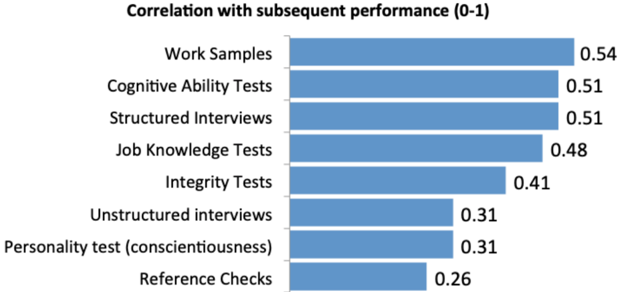
Strategy
Application Exercise 2 – Hiring a Team Leader (Optional)
Based on the information provided in Application Exercise 2, describe here why you would hire Carrie Candidate or Peggy Prospect to be the second-in-command of the DATA Team.
2.4 Hiring
- Using people analytics I will choose Peggy Prospect to be second-in-command of the DATA Team.
- Taking all correlations with subsequent preforamce in mind, Peggy’s adjusted score weighted equally with the test are 23.65 whereas Carrie is 23.19.
- This shows that Peggy is more suited for the role and that is why we choose Peggy.

Slide 9
Effects and Measurement

Slide 10
Effects
Describe the anticipated effects of your strategy
Please describe the anticipated effects of your strategy. Make sure you address the effects on customers, revenue, and the internal organization.
3.1 Main Effects
These changes will have an effect on the customers, revenue, and GYF.
3.2 Customers
This will improve online customer experience by customers being more likely to use the platform, when more innovative advertising strategies are used that are more user-friendly.
Trust and transparency will also improve with our customers because GYF has open communication with customers about advertising.
Enhanced engagement will also be a bonus with customers because the ads are more relevant to GYF customer demographic groups.
3.3 Revenue
An increase in revenue will also follow due to the key effect that ad revenue is increasing. This is done by implementing innovative ads that are less affected by adblockers, more advertisers will have more opportunities for GYF.
Diversified revenue will also play a factor due to the innovate advertising that diversify the revenue streams.
GYF will have a competitive advantage over their rivals, which will have customers switch from the rivals to GYF

Slide 11
Effects
Describe the anticipated effects of your strategy
Please describe the anticipated effects of your strategy. Make sure you address the effects on customers, revenue, and the internal organization.
3.4 Inside the Company
The internal origination will also have a positive effect by the increase of skill development that will be shown in the next slide.
Data-Driven Decision Making will also have a positive effect due to customer analytics and research tools.
Innovation plays a part in this too, with change like this one mean innovation with GYF.
3.5 Other Effects
The effects of market research will find some information about customers. This information of customers will be adjusted for the targeted ads demographic groups. With this information we can have more specific targeted ads through market research. Which will turn into more revenue. Also, through this information, we will make better ad campaigns that align with our customers. And this info can help shape predictive analytics to find out how many people will use GYF fantasy football in the years to come.

Slide 12
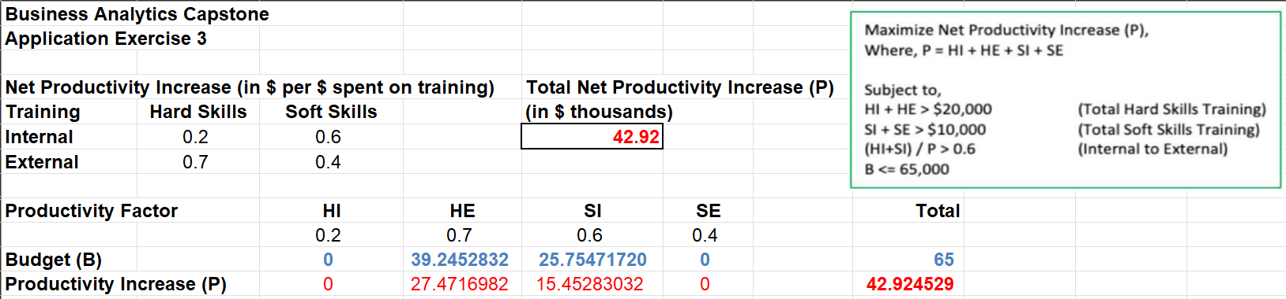
Effects
Application Exercise 3 – Designing a Deterministic Optimization Model
Provide an explanation of the calculations you performed to build an optimization model using decision variables, constraints, and an objective; this model could use the scenario in Application Exercise 3, or one of you own devising.
3.4 Optimization Model
The calculations below are shown from optimizing total net productivity with a training budget of $65,000. The constraints are below
Using both resource allocation and optimization model and the objective of maximum optimization I have found that GYF needs to focus a little more on their external sub-programs than internal sub-programs
These measurements show that the focus toward external sub-programs, and some focus on internal sub-programs.
Based on productivity return rates there is a 27.47 for external hard skills and a 15.45 for internal soft skills
This means that $39,245 worth of training for external hard skills will result in $27,472 worth of increased productivity in the next period. And $25,754 worth of training for internal soft skills will result in $15,458 worth of increased productivity in the next period

Slide 13
Measurement
Describe the anticipated effects of your strategy and how you will measure them
Please outline your plan for measuring these effects using data. Make sure you use techniques you learned about in the courses
4.1 Measuring’s effect on data
My plan for measuring these effects is to track the information when using the page. And when making a profile to sign up for fantasy football I can have customers fill out some of my variables in the signup and others being through a survey which could win the customer a chance at a big prize.
GYF needs predictive analysis that would describe the causal relationship between factors that dive outcomes based on GYF’s strategy.
A regression and correlation analysis to see if the variables affect revenue and if there is a correlation between the business models and non-financial measures.
These measurements will be integers for most variables but for others that aren’t like sex, and race they will be assigned a hidden number that will make it easier to bring out data on certain demographic groups.
Also we will track user interactions, user profiles, surveys, data integration, iteration, and data analytics.
A/B testing will also be used to determine the causal linkage between the implementation of adblocker mitigation strategies and revenue

Slide 14
Measurement
Application Exercise 4 – Identifying Key Drivers
Apply the “causal business model” performance measurement framework to your strategy
4.2 Causal Business Model
The hypothesis that adblockers directly affects revenue is true, and we need innovate ways of advertising to help revenue grow.
From this project we now know that this is true.
The key driver of this is implementation of adblocker mitigation strategies, that combats the negative effect of adblockers
The measure of the key driver is the ad revenue, user feedback, user engagement, and adb locker usage
One way of verifying the link is a A/B test, to see the causal linkage between the implementation of adblocker mitigation strategies and revenue. This would be done in two groups A & B:
Group A: Users who are exposed to the latest mitigation strategy for adblockers.
Group B: Controlled group that users us the site without the strategies
This will determine the causal impact of the strategies on revenue
A clear causal link between strategy implementation and revenue may be demonstrated if Group A shows a notable rise in both ad income and user engagement when compared to Group B.

Slide 15
Conclusion
Summarize your key points from the preceding slides
In conclusion, the market research found some information about customers. And this info was adjusted to targeted ads for the different demographic groups. Which in turn, became more specific targeted ads through market research and increased revenue. The info obtained made better ad campaigns and gave us a bar to hit through predictive analytics for the next year as well as the average among the rivals. We find out how many people will use GYF fantasy football and increase its rev.
Through the use of cutting-edge ad formats, the plan seeks to improve user engagement, promote transparency, and improve the online consumer experience.
Its goal is to reduce the influence of adblockers in order to increase ad income and diversify revenue sources.
Measurable indicators like click-through rates and user comments offer insight into the strategy's impact on customers, revenue, and internal organization.
Adblockers and revenue are directly correlated, as the causal business model suggests. This relationship may be confirmed using A/B testing to show a causal association with the plan that was put into practice.

